Slide 1
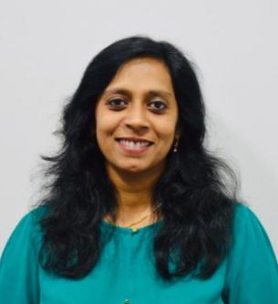
Veena Samartha
Veena is a successful entrepreneur with 20+ years of experience,
Developing high-performing teams and creating sustainable businesses. She has successfully built, nurtured and expanded passionate technology teams to deliver innovative products & solutions for the global market.
VeCrear Technologies Pvt Ltd as Executive Director & CEO
Hewlett Packard India as Senior Manager of the R&D division, BPL Systems and Wipro
Bachelors in Electronics & Communication Engineering from Masters in Philosophy & Religion.
Executive Director & CEO
VeCrear Technologies Pvt. Ltd
Notes:
Veena is a successful entrepreneur providing strategic direction, financial structuring, operational
efficiency and technology leadership in uniquely challenging situations, as the executive head.
With 20+ years of experience, Veena is a dynamic, results-oriented leader with a strong track record of
Developing high-performing teams and creating sustainable businesses. She has successfully built,
nurtured and expanded passionate technology teams to deliver innovative products & solutions for the
global market. The depth and breadth of her technical leadership combined with business acumen has
enabled a range of technology enterprises, from services outfits like Wipro, product corporates like BPL &
HP and IoT startups like Aseema & VeCrear, to grow top line, trim operating costs and ensure high quality
delivery of smart solutions in every situation.
Career Affiliations:
• VeCrear Technologies Pvt Ltd as Executive Director & CEO
• VeCrear Technologies Pvt Ltd as Executive Director, Aseema Softnet Technologies Pvt Ltd
• Hewlett Packard India as Senior Manager of the R&D division
• Wipro India as Project Manager
• Riverrun Software Group, DCM Data Systems & BPL Systems as Senior Engineer
Apart from her bachelor’s degree in Electronics & Communication Engineering from Bangalore
University she also has a Masters in Philosophy & Religion.

Slide 2
IoT for a Smarter World
Notes:
We are all in the world today of devices talking to each other seamlessly with or without human intervention.
Extending the power of the internet beyond computers and smartphones to a whole range of other things, processes and environments is what IoT is about.

Slide 3
Let’s Kickstart
Notes:
So let’s KICKSTART!
Where is IoT today? Applications – use cases & technology ,
Future Trends - AI / ML , Roadblocks
Challenges - Technology non – uniformity, Standardisation & integrations
Parting thought – IoT as a friend , IoT to enrich humanity
Ppt more on the subjective basis
Playing chess
Translating thoughts

Slide 4
Technology Aficionados
Agility
Smart Infrastructure
GNSS
Mobility
Big Data
Edge
Zigbee
Enterprise
Cloud computing
Applications
Bluetooth
Barcode
Sensors
Home Automation
Engineering
Notes:
Building solutions which are
Sustainable
Reliable
Future Ready
Unarticulated
Cost efficient
High quality

Slide 5
Notes:
The major trends in the IoT domain

Slide 6
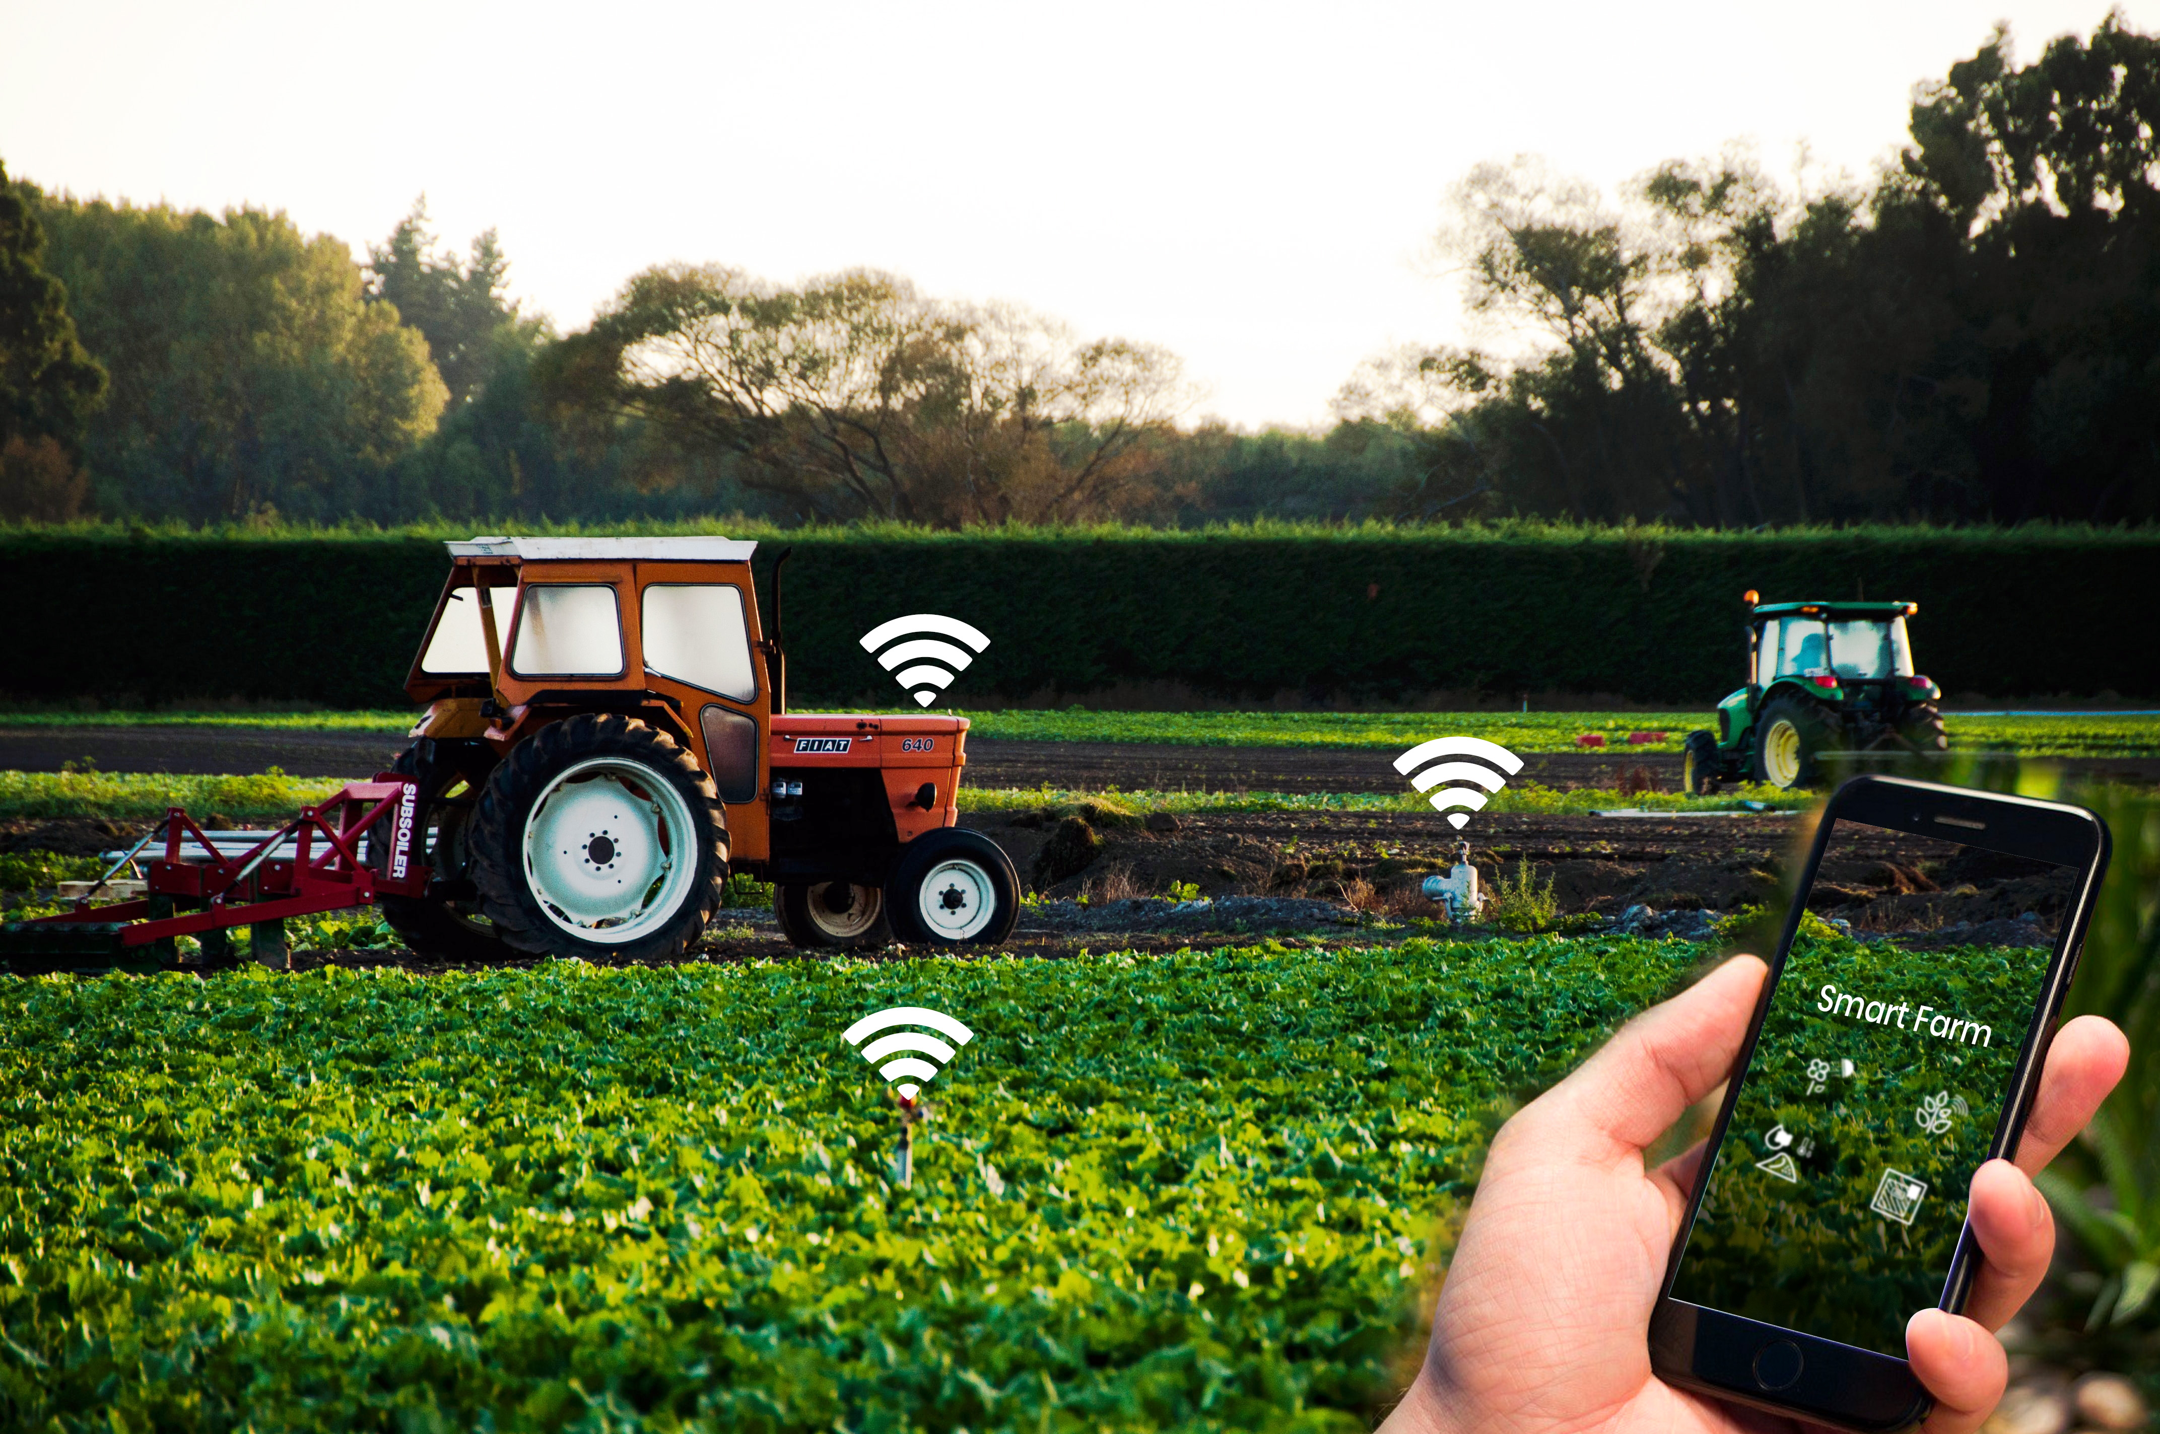
IoT TODAY
Weather monitoring &
forecasting
Sensor based
precision agriculture
Remote crop
monitoring
More trust
towards doctors
Better treatment
Results
Maintenance of
Medical Devices

Slide 7
IoT TODAY
Safer Communities
Improved Public
Health
Enhance Citizen &
Government Engagement
Improved
Transportation &
Lesser Pollution
Efficient Public
Utilities
Effective Data
Driven Decision Making

Slide 8
FROM TALKING DEVICES TO CREATING VALUE
Devices Connection
IoT devices & Connectivity
Embedded Intelligence - SD RAM, SD card, BT, BLE, WiFi
Value
Smart Applications
Stakeholder benefits
06
01
Value
Devices Connection
05
Data Sensing
Data capture
Sensors
Zigbee, SNMP, MQTT, TR069, SIP, AMQP
Smart Data
Analysis to action
Process Intelligence
Actionable Intelligence
Smart Data
02
Data Sensing
Data Analytics
Big Data
AI & ML
Edge Analytics
04
03
Data Analytics
Communication
Communication
USB 2.0, USB 3.0,WLAN, UART Cloud & Edge Servers
Gateway & Custom controllers
Notes:
More pictorial

Slide 9
CHALLENGES
Intelligent Analytics
Delivering Value
Data Security & Privacy
Standardization &
Interoperability
Handling Unstructured Data
Customization
Notes:
Customization point to be added
Slide needs to give an impression of the challenge / better representation

Slide 10
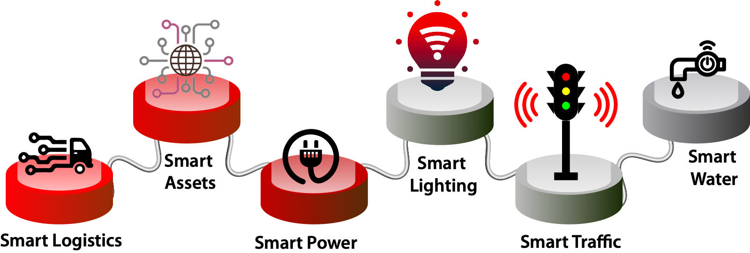
AMALGAMATION ACROSS DOMAINS
Devices, Application, Analytics - AI , ML , Virtual Reality with Security
Notes:
Better representation

Slide 11
TRANSPORTATION + SMART CITIES
Source :Postscapes
Notes:
Add the environment factor in the same slide .. Like traffic management.

Slide 12
WAREHOUSE MANAGEMENT + TRANSPORTATION
Intelligent software and self learning capabilities

Slide 13
FINAL THOUGHTS
Communication beyond sight and sound
World of emotions
Responsible & Sustainable IoT Solutions

